Slide 1


Angular
Aruna S
Department of
Computer Science and Engineering

Slide 2

angular
Component Styles and Interactions
S. Aruna
Department of Computer Science and Engineering

Slide 3
Angular
Component Styles
Component Styles

Slide 4
Angular
Components – Loading component styles
There are several ways to add styles to a component:
By setting styles or styleUrls metadata.
Inline in the template HTML.
With CSS imports.

Slide 5
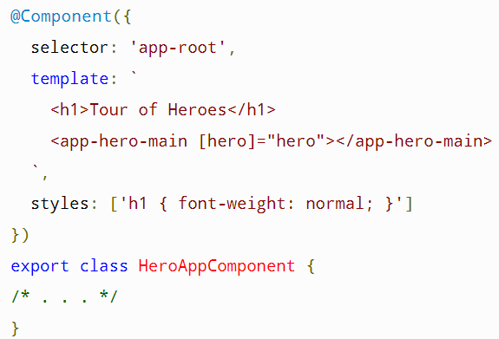
Angular
Components – Styles in component metadata
You can add a styles array property to the @Component decorator.
Each string in the array defines some CSS for this component.
The styles specified in @Component metadata apply only within the template of that component.
They are not inherited by any components nested within the template nor by any content projected into the component.

Slide 6
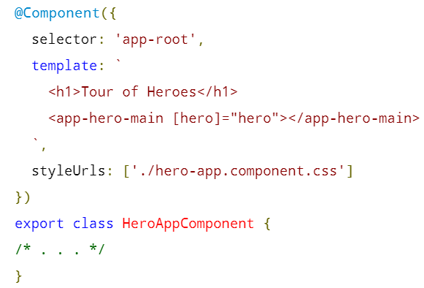
Angular
Components – Style files in component metadata
You can load styles from external CSS files by adding a styleUrls property to a component's @Component decorator
The styles in the style file apply only to this component. They are not inherited by any components nested within the template nor by any content projected into the component.

Slide 7
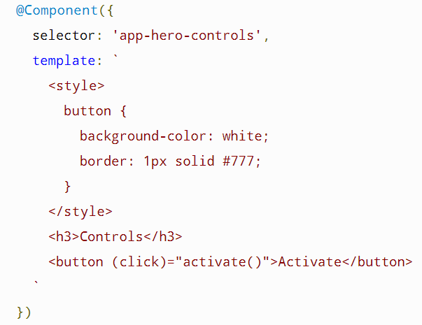
Angular
Components – Template inline styles
You can embed CSS styles directly into the HTML template by putting them inside <style> tags.

Slide 8
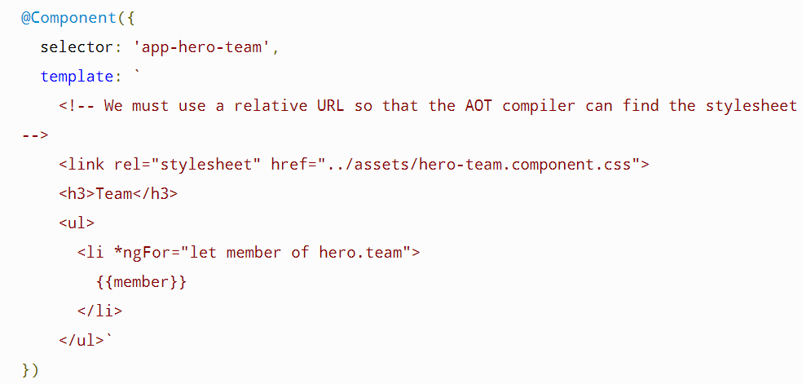
Angular
Components – Template Link Tags
You can also write <link> tags into the component's HTML template.

Slide 9
Angular
Components
User Inputs

Slide 10
Angular
Components – User Inputs
User actions such as clicking a link, pushing a button, and entering text raise DOM events.
Use Angular event bindings to respond to any DOM event. Many DOM events are triggered by user input.
To bind to a DOM event, surround the DOM event name in parentheses and assign a quoted template statement to it.
For example:
The (click) to the left of the equals sign identifies the button's click event as the target of the binding. The text in quotes to the right of the equals sign is the template statement, which responds to the click event by calling the component's onClickMe method.

Slide 11
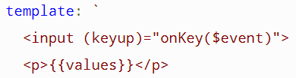
Angular
Components - User Inputs
Get user input from the $event object
DOM events carry a payload of information that may be useful to the component
For example:
bind to the keyup event of an input box to get the user's input after each keystroke.
Get user input from a template reference variable
Key event filtering (with key.enter)

Slide 12
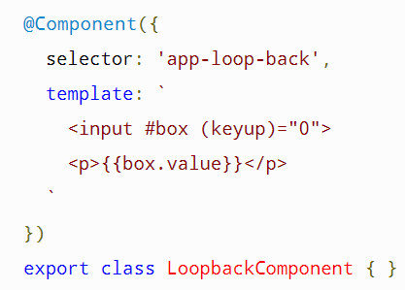
Angular
Components – User Inputs
Get user input from a template reference variable and Key event filtering (with key.enter)
Use Angular template reference variables to get the user data.
These variables provide direct access to an element from within the template.
To declare a template reference variable, precede an identifier with a hash (or pound) character (#).
The following snapshot uses a template reference variable to implement a keystroke loopback in a simple template.

Slide 13
Angular
Components
Component Interactions - Inputs and Outputs

Slide 14
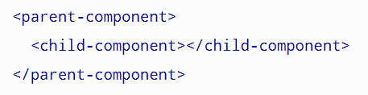
Angular
Components – Inputs and Outputs
@Input() and @Output() allow Angular to share data between the parent context and child directives or components.
An @Input() property is writable while an @Output() property is observable.
Here, the <child-component> selector, or child directive, is embedded within a <parent-component>, which serves as the child's context.
@Input() and @Output() act as the API, or application programming interface, of the child component in that they allow the child to communicate with the parent.

Slide 15
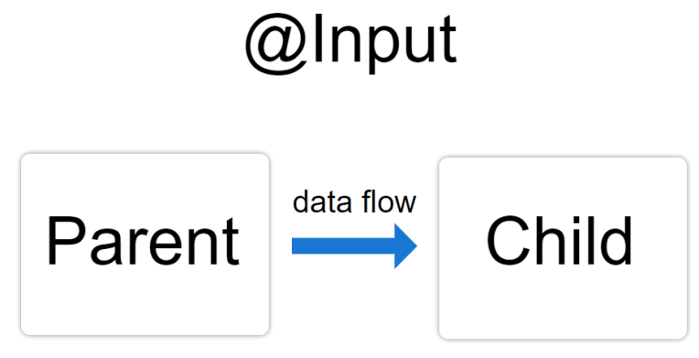
Angular
Components – @Input()
@Input() is the doorway into the component allowing data to flow in while @Output() is the doorway out of the component, allowing the child component to send data out.
Use the @Input() decorator in a child component or directive to let Angular know that a property in that component can receive its value from its parent component.
It helps to remember that the data flow is from the perspective of the child component.
@Input() allows data to be input into the child component from the parent component.

Slide 16
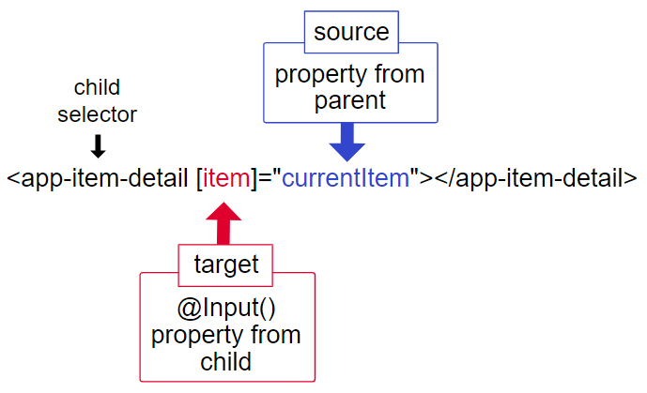
Angular
Components – @Input()
The target in the square brackets, [], is the property you decorate with @Input() in the child component.
The binding source, the part to the right of the equal sign, is the data that the parent component passes to the nested component.

Slide 17
Angular
Components – @Output()
Use the @Output() decorator in the child component or directive to allow data to flow from the child out to the parent.
An @Output() property should normally be initialized to an Angular EventEmitter with values flowing out of the component as events.
use @Output() on a property of the child component but its type should be EventEmitter.

Slide 18
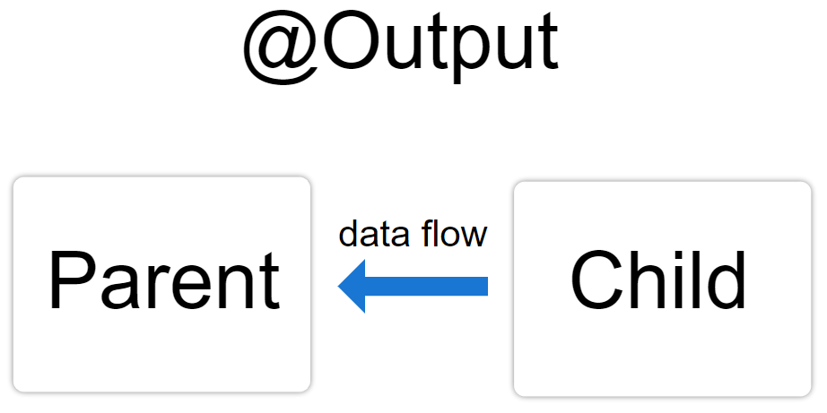
Angular
Components – @Output()
@Output() marks a property in a child component as a doorway through which data can travel from the child to the parent.
The child component then has to raise an event so the parent knows something has changed.
To raise an event, @Output() works hand in hand with EventEmitter, which is a class in @angular/core that you use to emit custom events.

Slide 19
THANK YOU
Aruna S
Department of
Computer Science and Engineering
arunas@pes.edu

